Slide 1

Restaurant ordering program
Presented to:
Ms.sheba pari
presented BY:
Jitendra sah
1NH17cs059 3rd
CSE DEPT. , NHCE

Slide 2
Restaurant ordering program
The following report details the development of a restaurant ordering program to keep track of orders and provide cohesion between the three main elements of a restaurant business – the restaurant floor, the kitchen, and the back office.
Waiters have an interface they can use to take orders, the order then shows up on an interface for the kitchen staff to complete

Slide 3
Use of software
The purpose of developing this program is to computerized the tradition way of taking orders from the customers
Another purpose for developing this software is to generate the order report automatically at the end of the session

Slide 4
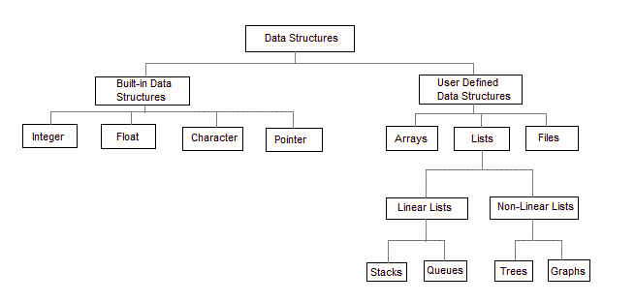
Data structure
Data Structure is a way of collecting and organizing data in such a way that we can perform operations on these data in an effective way.
Data Structures is about rendering data elements in terms of some relationship, for better organization and storage.

Slide 5
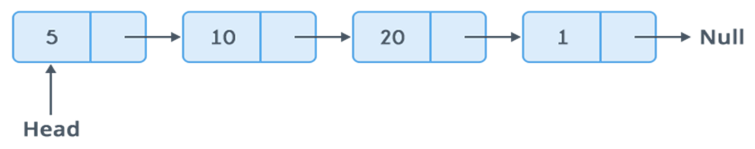
Linked lists
A linked list is a way to store a collection of elements. Like an array these can be character or integers. Each element in a linked list is stored in the form of a node.

Slide 6
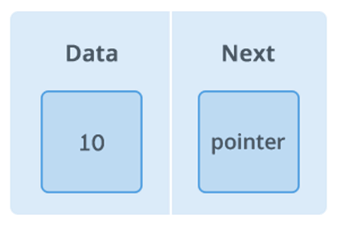
Node of a linked list
A node is a collection of two sub-elements or parts. A data part that stores the element and a next part that stores the link to the next node.

Slide 7
conclusion
This program is developed to manage the restaurant billing and ordering system.
This program is especially for small level restaurant and helps to serve as higher level restaurant. In this program I have used linked list to make it as a easier program. Finally this will help to restaurant

Slide 8
THANK YOU!

